Slide 1
Computer Hardware

Slide 2
Computer hardware is a physical device of computers that we can see and touch.
For e.g. Monitor, CPU, Mouse, Joystick, etc.
Hardware Components are:
1)Input Unit
2)Output Unit
3)Memory Unit
4)ALU
5)CPU
6)Secondary storage

Slide 3
1)Input Unit
With the help of input devices the users can interact with the computer.
some input devices: Keyboard, Mouse, Scanner, Trackball, Microphone etc

Slide 4
2) Output Unit
These are the devices that are used to display the output of any task given to the computer in human-readable form.
some output devices:Monitor, Printer, Speakers, Plotter

Slide 5
3) Memory Unit
Memory units are used to measure and represent data. Some of the commonly used memory units are:
Bit: The computer memory units start from bit. A bit is the smallest memory unit to measure data stored in main memory and storage devices. A bit can have only one binary value out of 0 and 1.
Byte: It is the fundamental unit to measure data.
Kilobyte: A kilobyte contains 1024 bytes.
Megabyte: A megabyte contains 1024 kilobytes.
Gigabyte: A gigabyte contains 1024 megabyte.
Terabyte: A terabyte contains 1024 gigabytes.

Slide 6
ALU- Arithmetic logic unit
An arithmetic logic unit(ALU) is a major component of the central processing unit of the a computer system.
It does all processes related to arithmetic and logic operations that need to be done on instruction words.
Arithmetic Logic Unit , which is capable of performing logical operations (e.g. AND, OR, Ex-OR, Invert etc.)

Slide 7
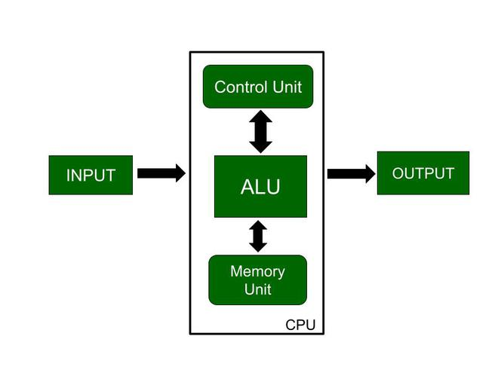
CPU-Central Processing Unit
CPU is also known as the heart of the computer.
It consists of three units, in general known as the control unit, Arithmetic Logical Unit (ALU), and the memory unit.

Slide 8
Secondary Storage Devices
A secondary storage device refers to any non-volatile storage device that is internal or external to the computer.
The Secondary storage media can be fixed or removable.
Fixed storage is an internal media device used by a computer system to store data.
Internal flash memory (rare)
SSD (solid-state disk) units
Hard disk drives (HDD)
Removable storage is an external media device that is used by a computer system to store data.
Optical discs (CDs, DVDs, Blu-ray discs)
Memory cards
Floppy disks

